Slide 1
High-Impact Practices (HIPs) Virtual Learning Community Orientation
Faculty Professional Learning Core Team
Spring 2022 Professional Development Week
Thursday, January 13, 2022

Slide 2





Orientation Agenda
Professional Learning Core Team & Learning Community Moderators
Why HIPs?
Fall 2021 Update
What's in Store this Semester
Deliverables & Deadlines

Slide 3
Title III Faculty PL Core Team Leadership
Sharmon Bryant, Associate Director, Title III grant
Girija Nagaswami, Professor of English and Faculty Center for Teaching & Learning (FCTL) Facilitator
Stephanie Scordia, Associate Professor of English and Professional Learning Coordinator, Title III grant

Slide 4
Title III Faculty Professional Learning Core Team
Edite Birnbaum
Foundational Math
Khalica Collins
Advising
Judy Cruz-Ransom
Criminal Justice
Taoufik Ennoure
Computer Technologies
Catherine Malele
Chemistry
Jennifer Schneider
Paralegal Studies
Jocelyn Sirkis
Business Leadership, Fashion, & Hospitality
Christine Veal
Nursing

Slide 5
Virtual Learning Community (Canvas) Moderators
Jennifer Schneider, Active Learning
Taoufik Ennoure, Collaborative Learning
Jalyn Warren, Open Educational Resources
Nicole Vadino, Problem-Based Learning

Slide 6
Implementing High-Impact Practices at CCP
Active Learning is an approach to instruction that involves actively engaging students with course material through discussions, problem solving, case studies, role plays and other methods.
Collaborative Learning promotes interaction among students to optimize the learning experience. As a teaching method, it is based on students’ cooperation and sense of being a community of learners.
Open Educational Resources (OER) are teaching materials that exist in the public domain or have been released under an open license that permits no-cost access, use, and redistribution with no or limited restrictions.
Problem-Based Learning (PBL) is a teaching method in which complex real-world problems are used as the vehicle to promote student learning of concepts and principles as opposed to direct presentation of facts and concepts.

Slide 7
Benefits of High-Impact Practices
High-impact practices (HIPs) have been proven to be effective in helping first-year students successfully transition into college (Demetriou, Meece, Eaker-Rich, & Powell, 2017).
Research has shown persuasively that HIPs improve the quality of students' experience, learning, retention, and success (Watson, Kuh, Rhodes, Penny Light, & Chen, 2016).
Kuh (2008) describes strong positive effects of student participation in high-impact activities as measured by items from the National Survey of Student Engagement.
A comprehensive study involving 29 colleges and universities highlights the effectiveness of High-Impact practices in improving equity and closing achievement gaps (NSSE, 2015).
The associated benefits of High-Impact Practices rely heavily on effective implementation (Hobbs & Kropp, 2018)
Finley and McNair (2013) point to the need for pre- and posttest measures to increase the validity of the reported findings on benefits of HIPs for students.

Slide 8
Update from Fall 2021
Last semester, approximately 40 faculty participated in virtual learning communities in Active Learning, Collaborative Learning, Open Educational Resources (OER), and Problem-Based Learning.
Supported by the Faculty Professional Learning Core Team, faculty from across the College engaged in meaningful conversations with each other and reflected upon the impact of their chosen HIP on student outcomes in their classes.
Participants worked together to ensure the learning community was a productive, engaging experience as they met virtually and interacted with each other and the resources in the Canvas community.

Slide 9
"[HIP] was helpful because it is easier to learn when speaking with other students."
-Fall 2021 student
"I like working in groups because it helps me better understand the assignments assigned to me."
-Fall 2021 student
"Active Learning [is] a key component to teaching our students to be good team members both in school and at work. Although not all active learning involves groups and clear member roles, the reality is that in the work place our students need to be active members of teams at work who can solve routine and non-routine problems in all fields." -Learning Community participant
"This was a great experience. All of those who took part in the OER [community] benefitted from the time, thought, and energy that the planners put into designing the modules and the deliverables."
-Learning Community participant

Slide 10
Spring 2022 Experience
As part of a virtual learning community this semester, you will be asked to
Attend virtual orientation on Thursday, Jan. 13, 2022 (or view recording)
Accept the Canvas community invitation and familiarize yourself with the resources there
Engage in conversations with colleagues about the HIP and your experience implementing it in your class/es this semester
Notes:
As members of the Title III Professional Learning Core Team, we are hoping to expand the number of participants in the High-Impact Practices (HIPs) professional learning program in the spring by recruiting an additional 20 faculty members who are interested in incorporating a HIP into their teaching practice. As added incentive, the first 20 new faculty members who sign up will be offered a small stipend as compensation for participation.

Slide 11
Spring 2022 Experience
Complete two surveys (pre- and post-implementation)
Administer an anonymous student survey
Share assessment data with the Core Team (This involves linking an assignment to the most appropriate CLO/s in AEFIS. Training will be provided.)
Notes:
As members of the Title III Professional Learning Core Team, we are hoping to expand the number of participants in the High-Impact Practices (HIPs) professional learning program in the spring by recruiting an additional 20 faculty members who are interested in incorporating a HIP into their teaching practice. As added incentive, the first 20 faculty members who sign up will be offered a small stipend as compensation for participation. (indicating your level of HIP knowledge/experience pre- and post- participation, as well as reflections on your experience implementing the HIP and being part of the learning community)

Slide 12
Deliverables
What we need from you…and why

Slide 13
Deliverable #1: Pre-HIP Implementation Questionnaire
Outlook form to be completed at the beginning of term (end of the second week of classes)
Link to questionnaire in Canvas
Questions include:
  How does [the HIP] relate to your course learning outcomes?
  Given your prior experience teaching this course or a course with similar content, what would a meaningful, realistic positive outcome of [HIP] implementation look like for you/your students this semester?
  How do you plan to assess or measure the impact of the practice on your students?

Slide 14
Deliverable #2: Post-HIP Implementation Feedback
Outlook form for you to complete at the end of term (complete by end of finals week)
Link to form in Canvas
Prompts include:
  Assessment of student outcomes using qualitative and/or quantitative measures (measures could include pass rates, participation, attendance, % of completed assignments, etc…)
  Brief reflection on this PL experience (what worked well/what didn’t, benefits, obstacles, etc…)

Slide 15
Deliverable #3: HIP Assessment Data from AEFIS
Link an assignment to the most appropriate CLO/s in AEFIS
Send the Core Team a screenshot of the assessment data which shows how many students met the outcome/s, exceeded expectations, and didn't meet the outcome/s
Training will be provided

Slide 16
Deliverable #4: Anonymous Student Feedback
We will provide a brief survey to administer to your students at the end of the semester
Students are not required to complete the survey
All responses are anonymous (students indicate which HIP their professor implemented)

Slide 17
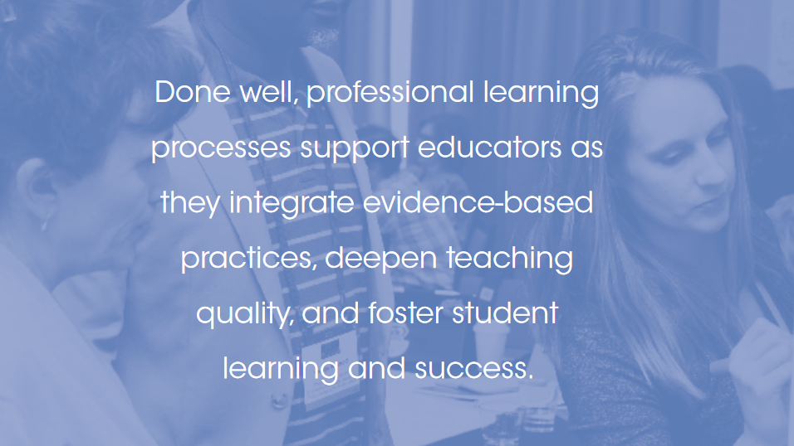

Slide 18
References
Demetriou, C., Meece, J., Eaker-Rich, D., Powell, C. (2017). The activities, roles, and relationships of successful first-generation college students. Journal of College Student Development, 58, 19-36.
Hobbs, P. and Kropp, E. – Faculty Focus, (2018). Leveraging High-Impact Practices at the Course Level
Finley, A., McNair, T. B. (2013). Assessing underserved students’ engagement in high impact practices. Washington, DC: Association of American Colleges and Universities.
Kuh, G. D. (2008). High-impact educational practices. Washington, DC: Association of American Colleges and Universities.
National Survey of Student Engagement. (2015). NSSE high-impact practices summary percentages. Bloomington, IN: Author. Retrieved from http://nsse.indiana.edu/2015_institutional_report/pdf/HIPTables/HIP.pdf
Watson, C. E., Kuh, G. D., Rhodes, T., Penny Light, T., and Chen, H. L. (2016). Editorial: ePortfolios – The Eleventh High Impact Practice. International Journal of ePortfolio, Vol. 6, No. 2.

Slide 19
Thank you!

