Slide 1

Service and Community Engaged Learning
Information Session
Michelle Lopez
Manager
Michael Miles
Community Engagement Specialist

Slide 2
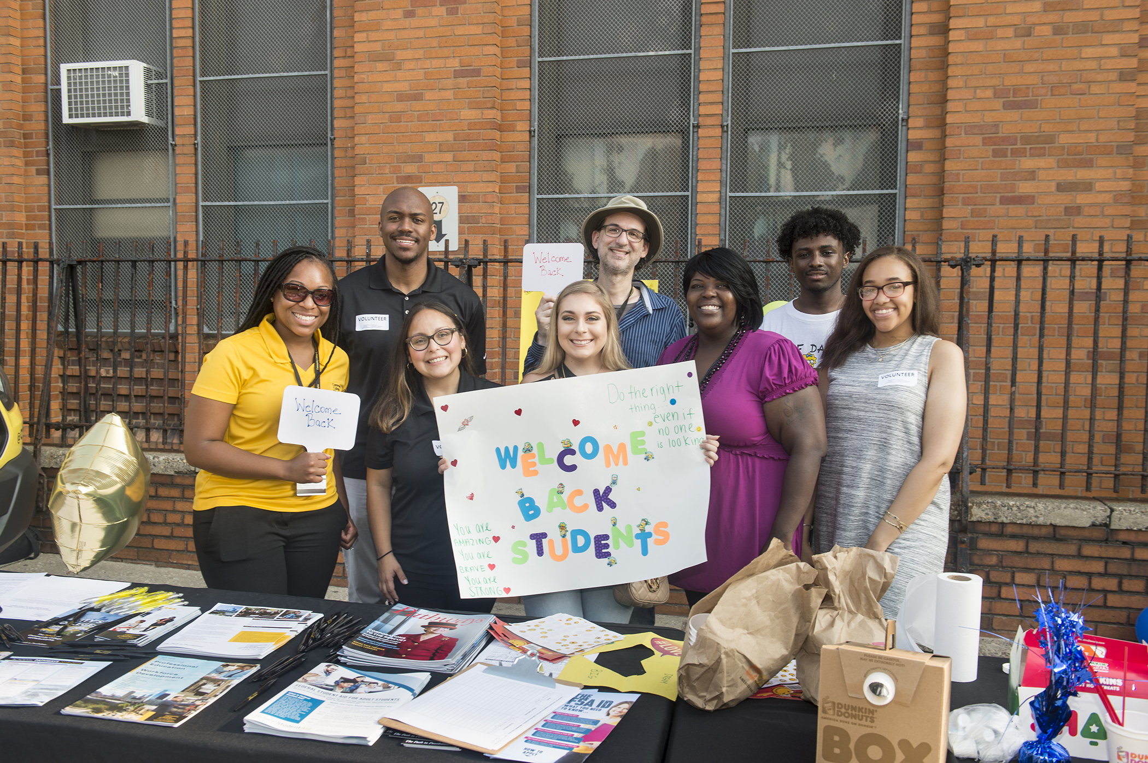
The institute for community engagement & civic leadership welcomes you!

Slide 3
Welcome & Introductions
Name
Role at the College, Department/Program
Tell us about a positive memory you’ve had during the Pandemic?

Slide 4
Session goal
To inform faculty members with ideas on how to integrate community engaged scholarship, service and student reflection to enrich the learning experience, teach civic responsibility and make a positive difference on social justice issues through the Institute for Community Engagement and
Civic Leadership.

Slide 5
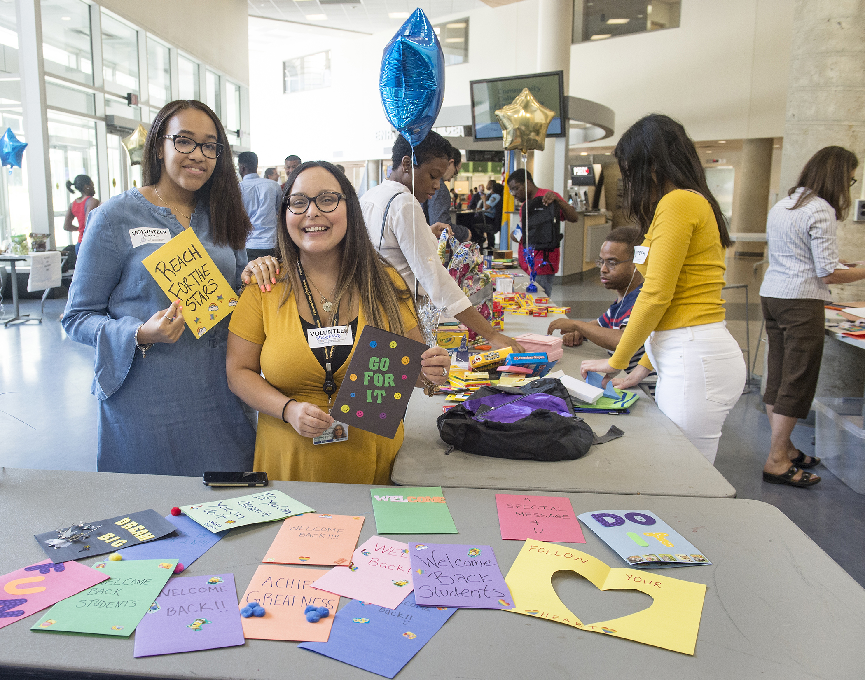
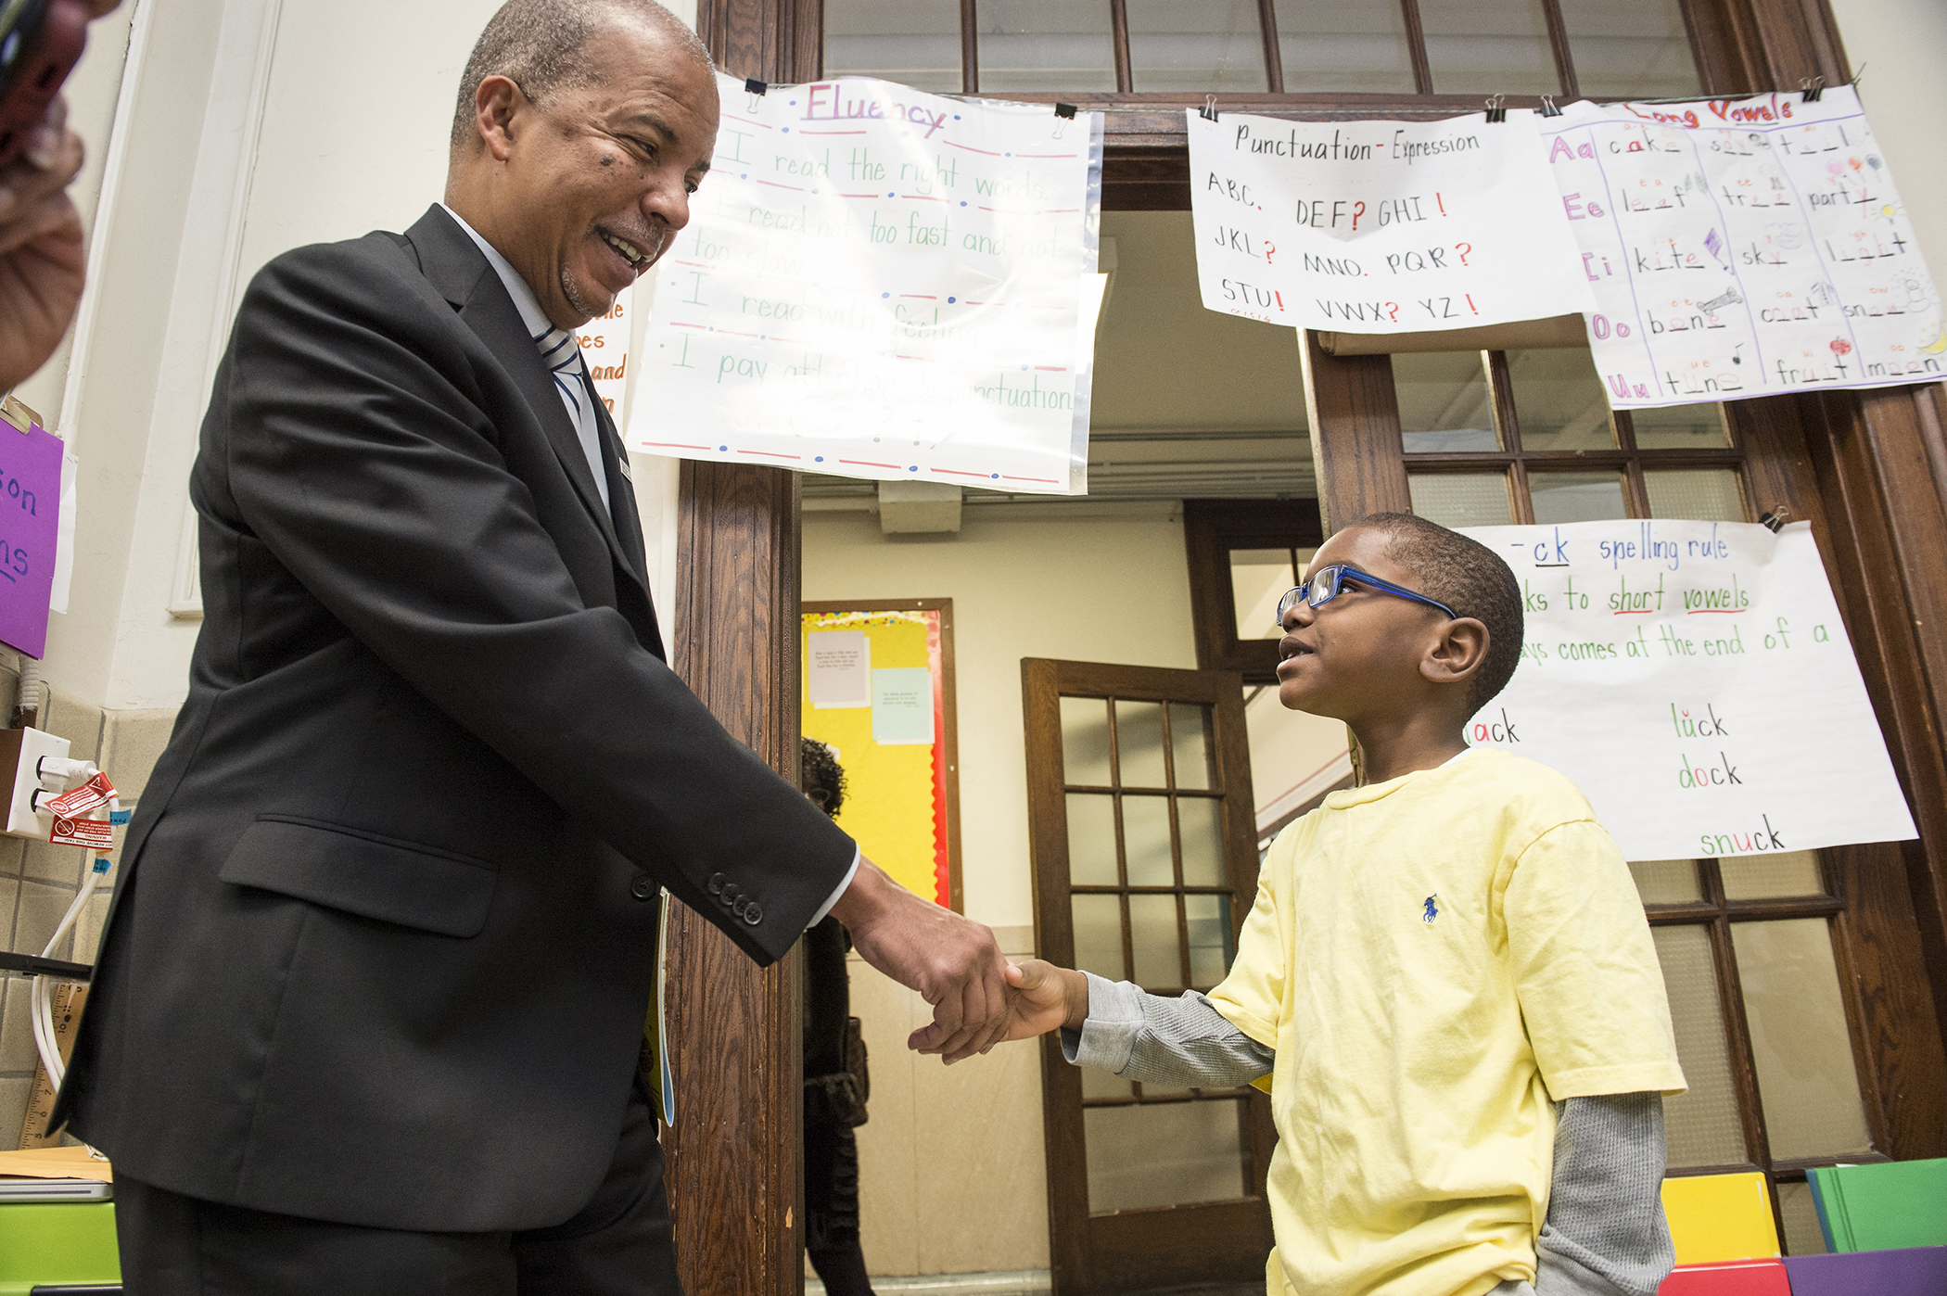
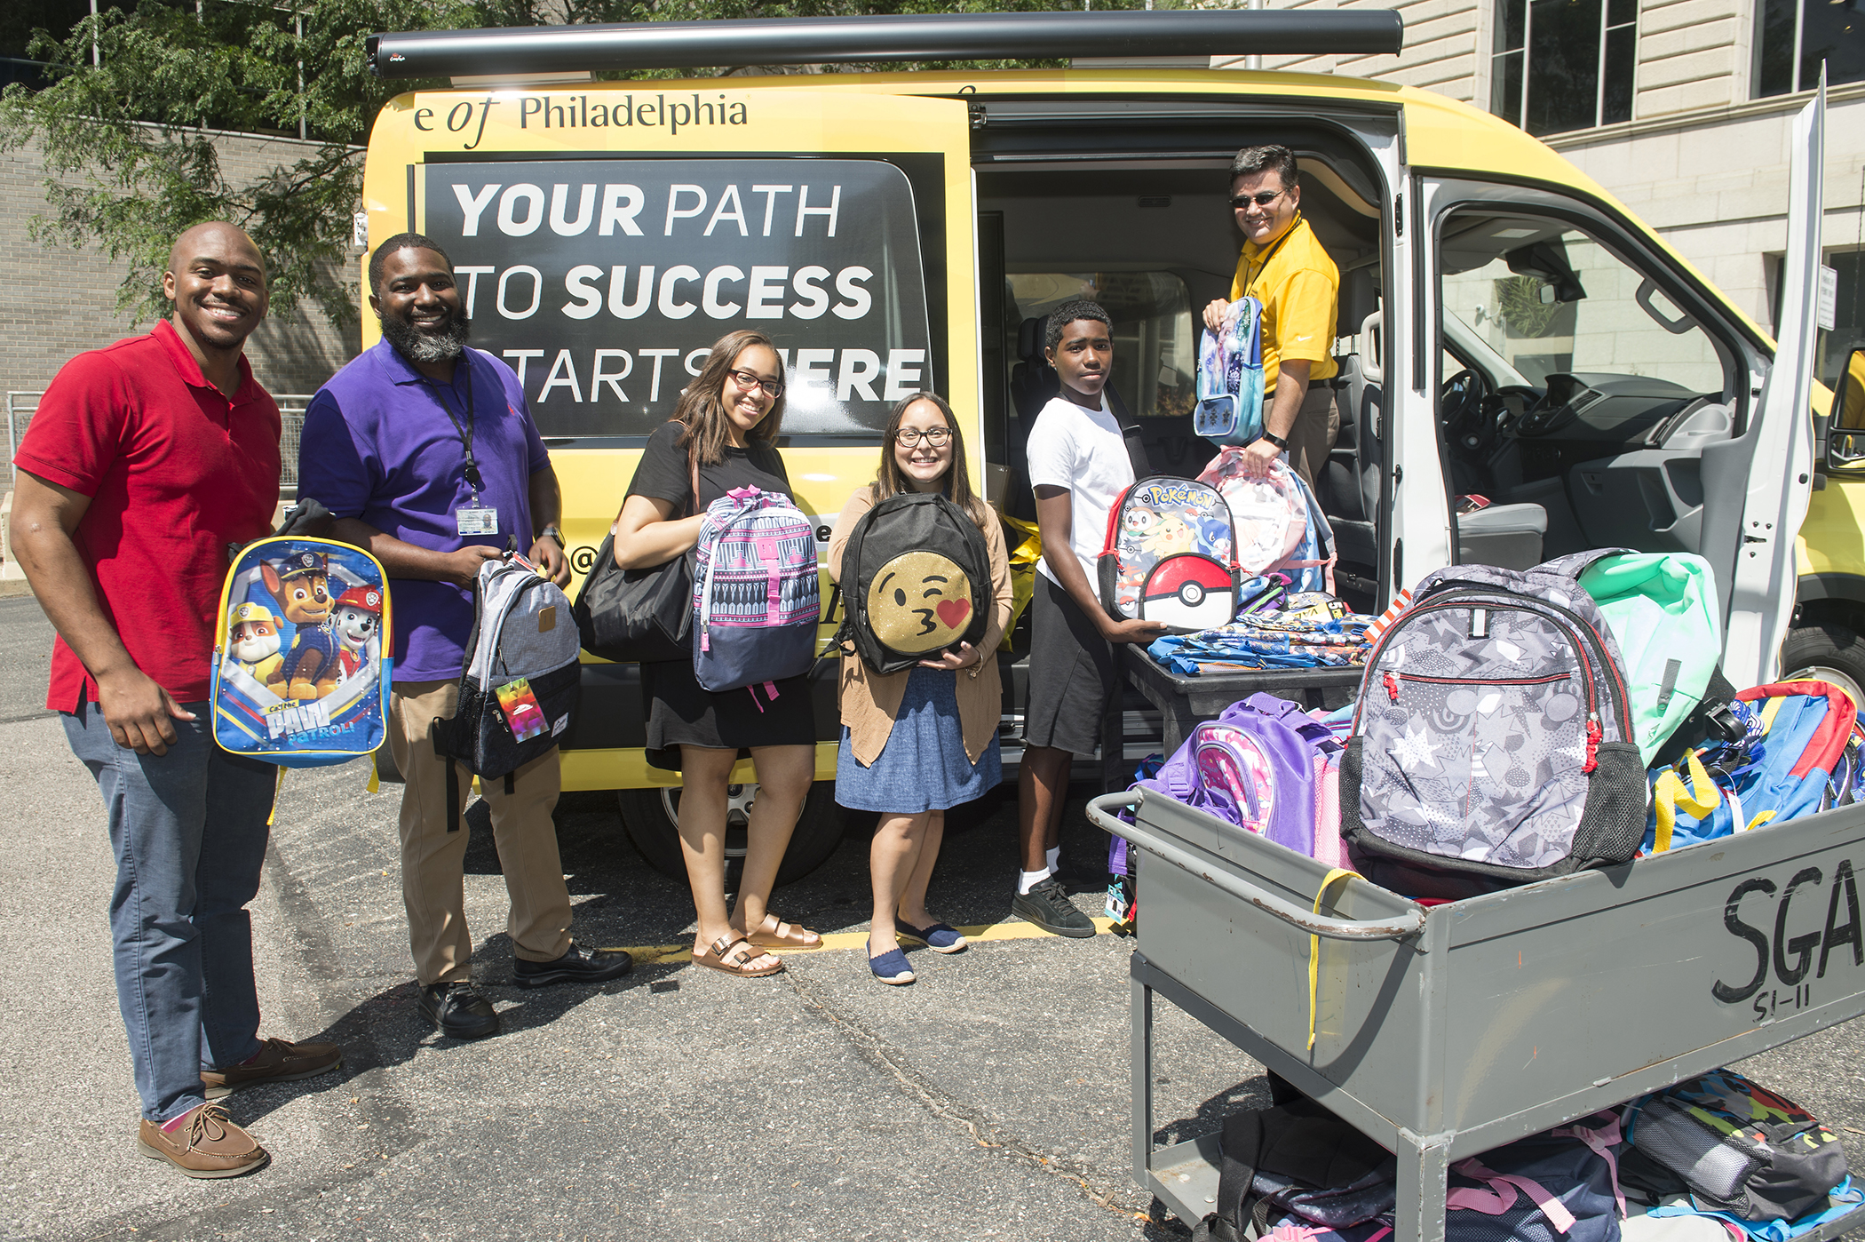
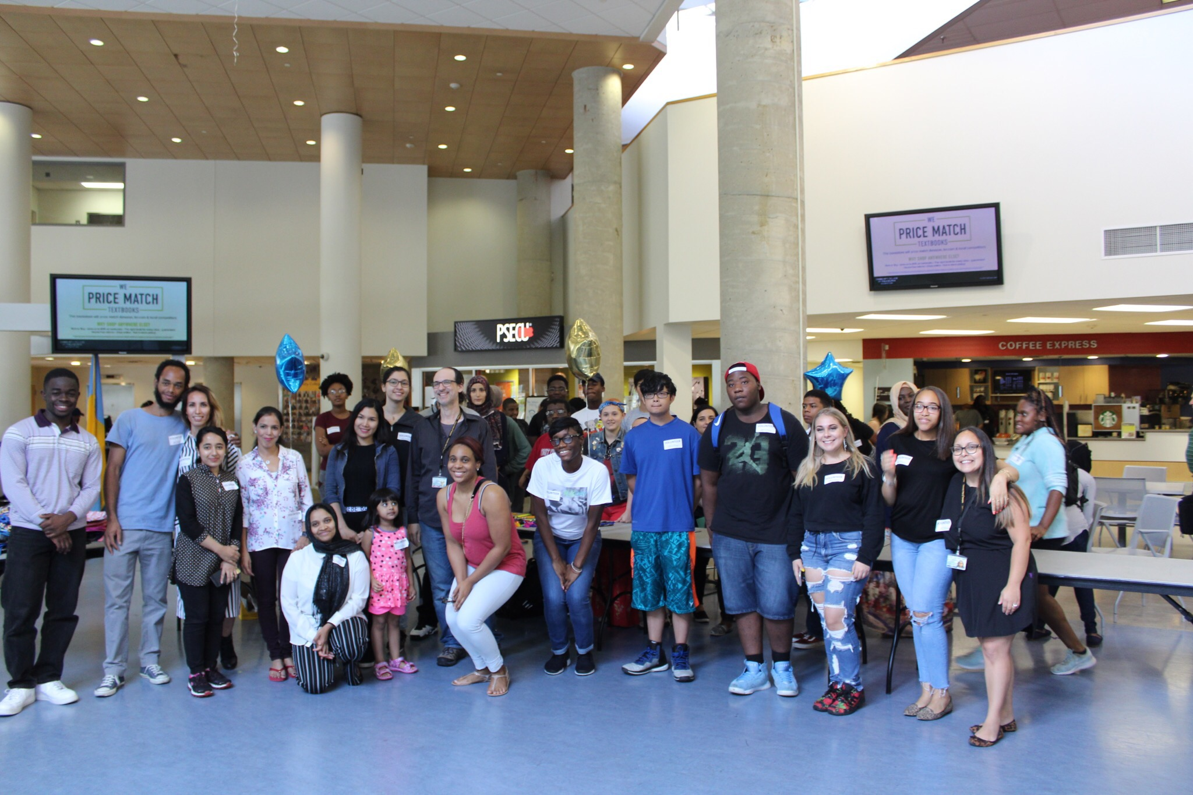
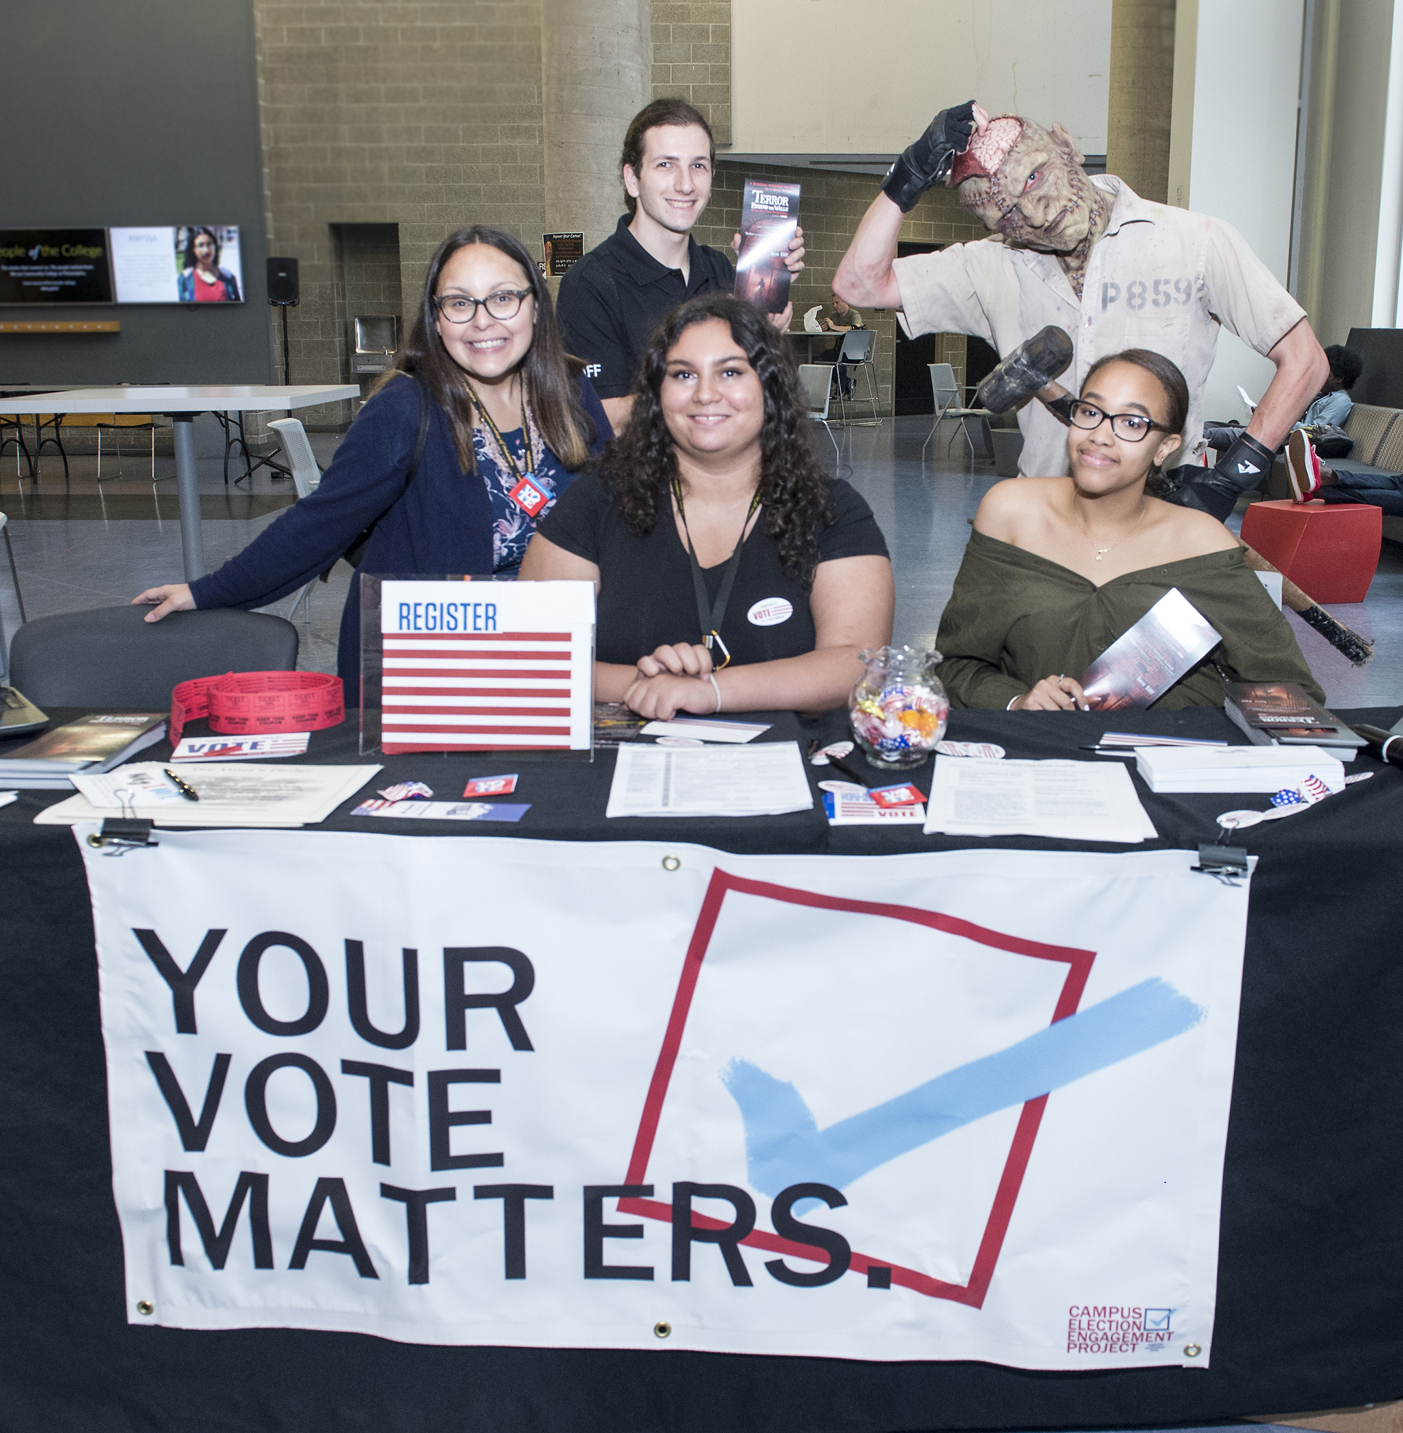

About us

Slide 6
Service and Community engaged Teaching and Learning
(Service Learning)
Decide on topic, issue or cause that is relevant to your class
Provide student service site options (virtually, close to home, school or work)
Provide project options: Research Project, Essays, Oral Presentations, Small Group Discussions, Group Projects/Presentations and/ or community service/volunteer project
Allow 1-3 hours to work on said project per week up to 3 weeks or more
Have students write Reflection Paper (How does the project impact society, students and what did they learn)
Assess students experience (conduct survey)
The format is up to the professor with support from the Institute

Slide 7
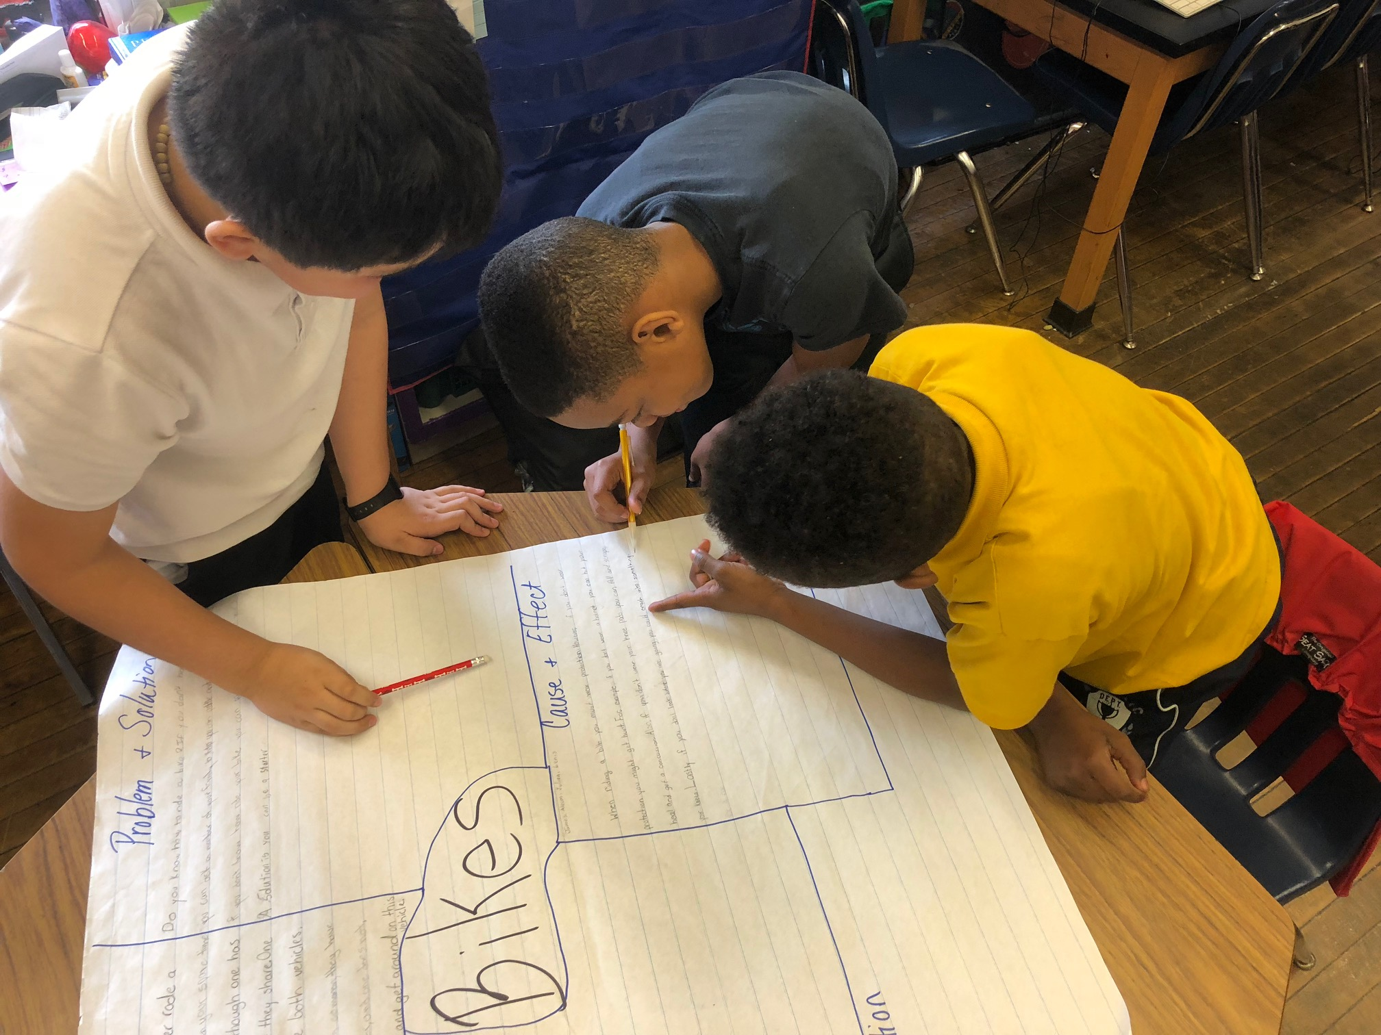
The Institute Services
Virtual Planning Meetings
Connection and introduction to community organizations
Virtual classroom visits to answer questions for students
Support with student clearances (if needed)
Navigate student and partner challenges
Ongoing communication and support with partners
Verification of time and service documents
Student Certificate of Completion & Eligibility for Scholarship
Service Learning Celebration

Slide 8
Semester of service
Fall and Spring Initiatives
Civic Engagement
#CCPVotes
Census
Covid-19
MLK Day
Education and Mentorship
Adopt-A-School Program
SPARK
Project Career Launch
Environmental Engagement
Cobbs Creek Park
Sankofa Farm
Philadelphia Parks and Recreation
Food and Housing Insecurity
Gather Initiative
Fostering Caring Connections
OHS Sock Drive

Slide 9
Project idea samples
Adopt -A-School
Tutoring and Homework Help
Tech support for students and families
Assistance with telephone calls to spanish speaking families or children that have disengaged from instruction
#CCPVotes
Classroom Presentation on the importance of voting
Classroom Presentation on how to get registered to vote
Classroom Presentation on how to learn more about candidates and issues
Fostering Caring Connections
Research Paper on Foster Care
Marketing Plan for Fostering Caring Connections Program

Slide 10
Project idea samples
Covid-19/Coronavirus
Essay about their experience
Thank an Essential Worker Project
Census
Research Paper
Census Reminders
Enough is Enough
Paper – Research or Essay – Racism, Police Brutality, Oppression
Classroom Presentations on above listed themes
Small Group Discussion regarding expression and feelings

Slide 11
Benefits & Incentives
We appreciate your service!
For Faculty:
Be a catalyst for change on campus and in the larger community
Lead a College-wide model
Receive Recognition
Receive a Certificate for Participation and Completion of Service Learning Program!
Do Good, Feel Good!
For Students:
Volunteer 2 times: Service Award Certificate and Volunteer T-shirt
Volunteer 4 or more times: Letter(s) of Recommendation (jobs, secondary education, references, etc.)
Scholarship Opportunities

Slide 12
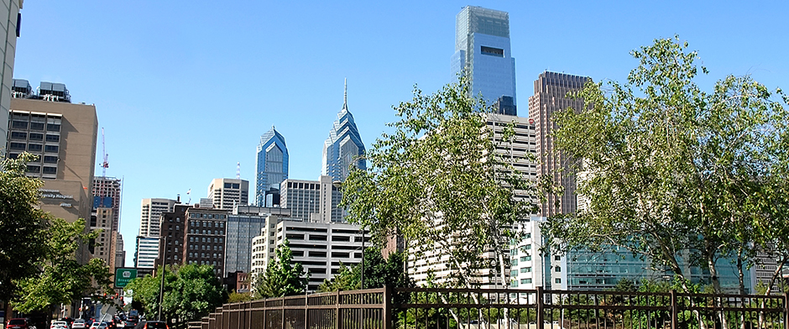
Let’s build together!
For more information:
institute@ccp.edu
www.ccp.edu/institute
www.ccp.edu/volunteer

