Slide 1


UKG/Kronos Timekeeping System
A Refresher for Community College of Philadelphia Employees
Try installing Poppins in template via desktop PPT
How to make custom frame: insert picture > go to "Crop" and click "crop to shape" > crop again to adjust shape itself but make sure picture is not stretched/compromised

Slide 2

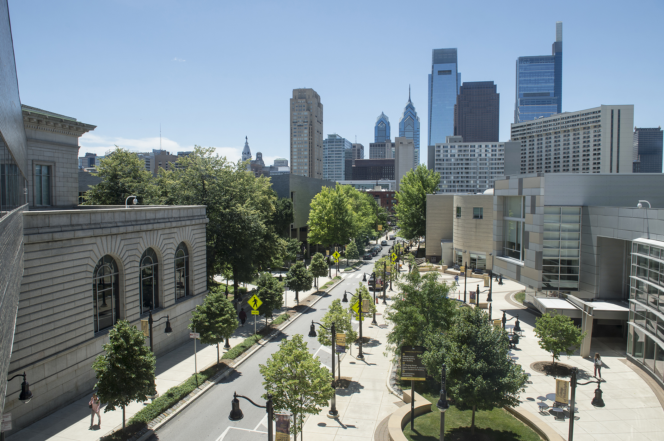
Topics Covered
Introduction to Kronos and Getting Started
Clock In and Out
View Your Timesheet
Timesheet Change Request
View Your Time Off Balances
View Your Time Off History
Request Time Off
PTO Eligibility
Resources and Support

Slide 3
Introduction to Kronos
The UKG/Kronos Timekeeping System is used to:
Record hours worked (for hourly employees)
Record and track time off (including sick, vacation and personal time)
Submit time off requests
View your weekly timesheets and submit timesheet change requests

Slide 4
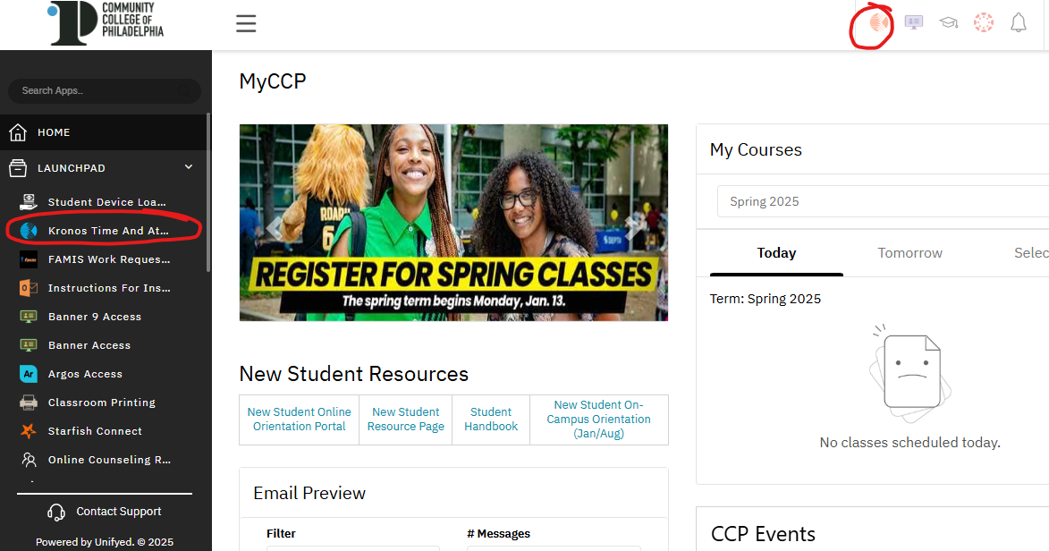
Getting Started With Kronos
To access Kronos:
Log in to MyCCP
Navigate to the Kronos icon
on the top right corner
Or, navigate to the menu on the left side of your MyCCP homepage
Click the Launchpad dropdown
Select Kronos Time and Attendance

Slide 5
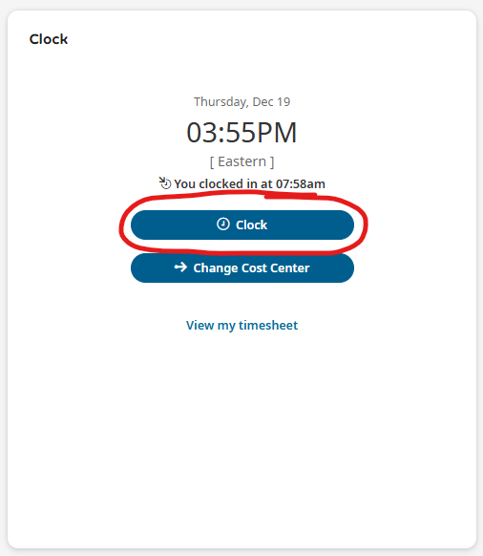
Clock In and Out (Hourly Employees)
To clock in and out on a web browser:
Once on your Kronos dashboard, find the Clock widget
Click the Clock button to clock in or out
If you do not see the clock widget on your Kronos dashboard, please contact the Kronos inbox at Kronos@ccp.edu

Slide 6
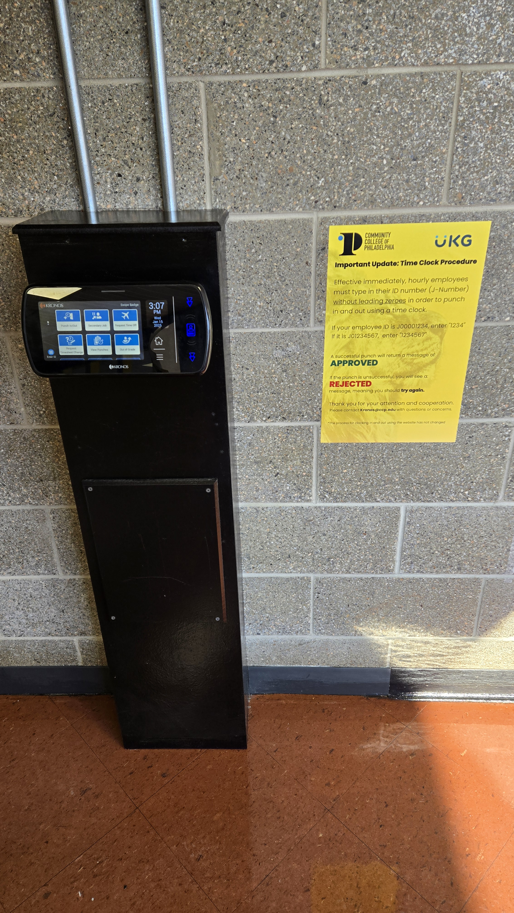
Clock In and Out
(Hourly Employees)
To clock in and out on a timeclock:
Select Punch In/Out
Type in your employee ID number (J-Number) without leading zeroes
  For example, if your employee ID is "J0001234," you should enter "1234"
A successful punch will display a green Accepted screen
If the punch is unsuccessful, a red Rejected screen will appear

Slide 7
Timeclock Locations
BG-12
BG-38 Cashier
CBI Security
Gym Lobby
MG-30D
MG-14
Mint Security
Mint to Bonnell 2nd Floor
NE-111
NE-113A
Pavilion Lobby
W2-01
Winnett Lobby
WPRC Chestnut Lobby

Slide 8
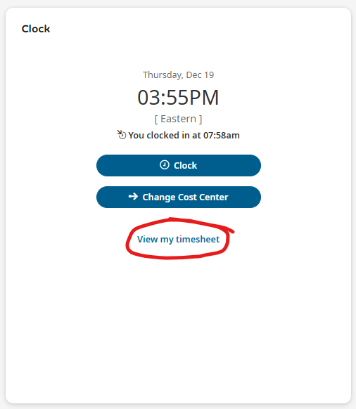
View Your Timesheet
To view your timesheet:
Find the Clock widget on your Kronos dashboard
Click View my timesheet
Once on your timesheet you can view:
Your schedule
Your hours worked
Any time off for that week

Slide 9
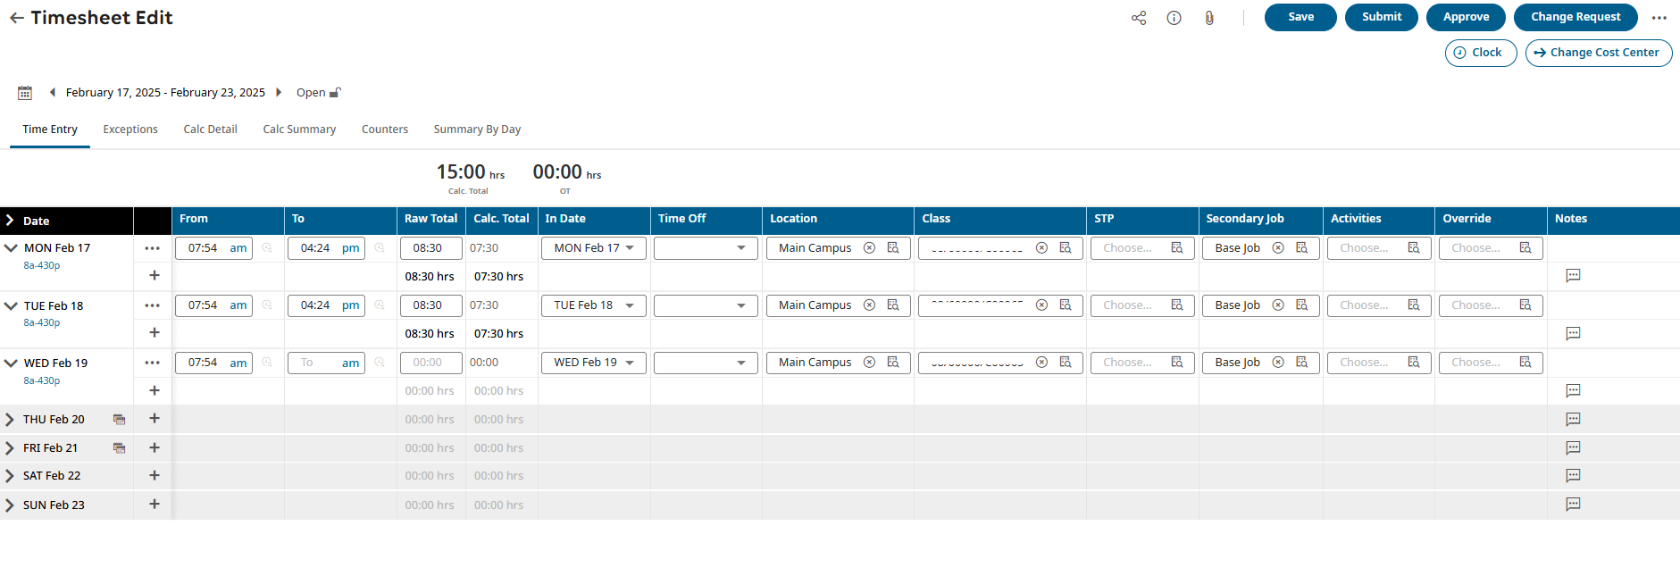
View Your Timesheet
Things to remember:
Hourly employees need clock in and out times in the From and To fields
Salaried employees need the number of hours in the Raw Total field only
There should be only one row per day, unless it is a partial day of PTO
Lunch breaks are automatically applied so you do not need to clock in and out for lunch

Slide 10
Timesheet Change Request
To submit a Timesheet Change Request:
For things like a missed punch, incorrect clock in/out time, etc.
At the top right corner above your timesheet, click Change Request
Select what type of change is needed
Enter the details
Click Submit Changes

Slide 11
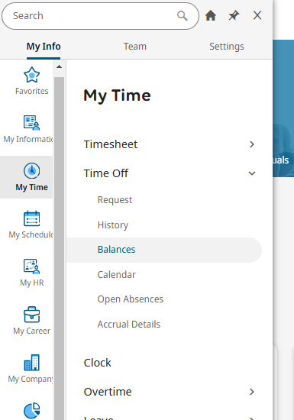
View Your Time Off Balances
To view your time off balances:
Navigate to the menu on the top left of your dashboard
Click My Time > Time Off > Balances

Slide 12
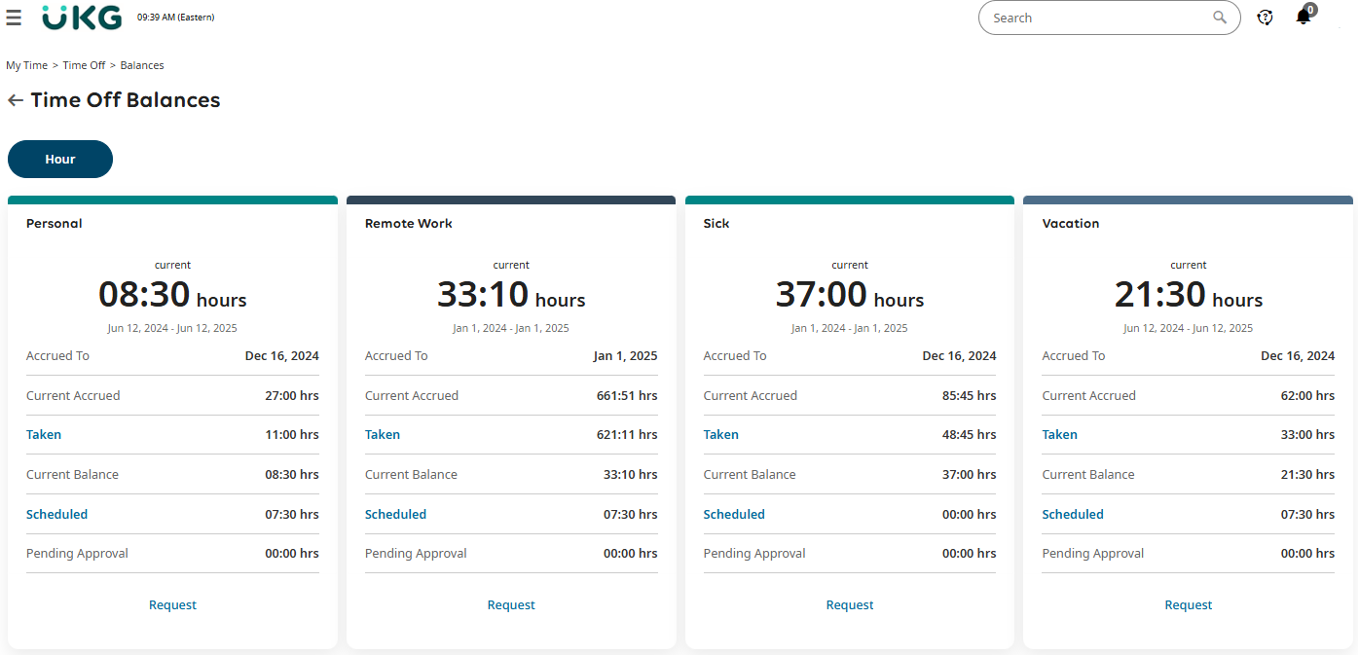
View Your Time Off Balances

Slide 13
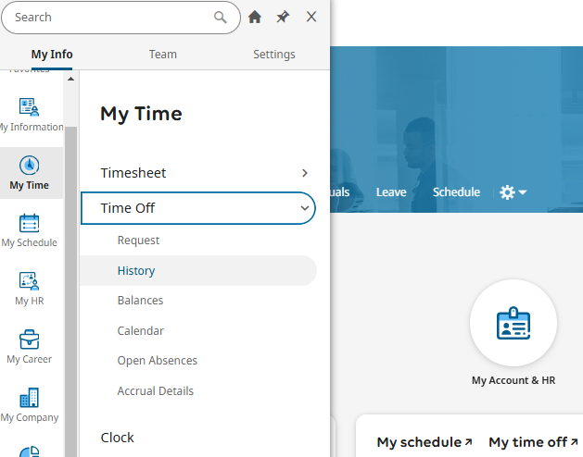
View Your Time Off History
To view your time off history:
Navigate to the menu on the top left of your dashboard
Click My Time > Time Off > History

Slide 14
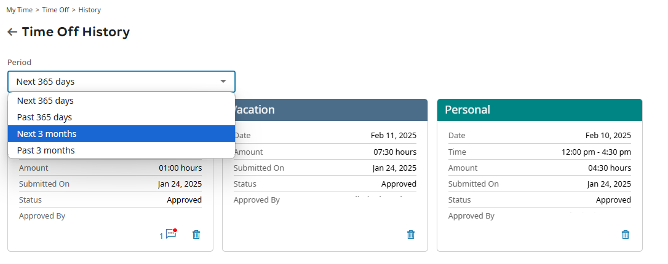
View Your Time Off History
Once on this page, you can choose the period of time you wish to view

Slide 15
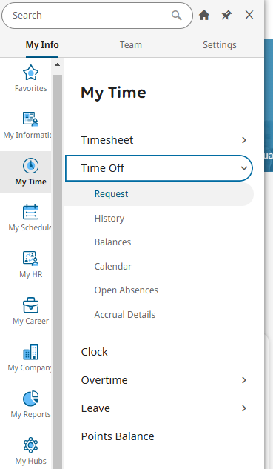
Request Time Off
To request time off:
Navigate to the menu on the top left of your dashboard
Click My Time > Time Off > Request

Slide 16
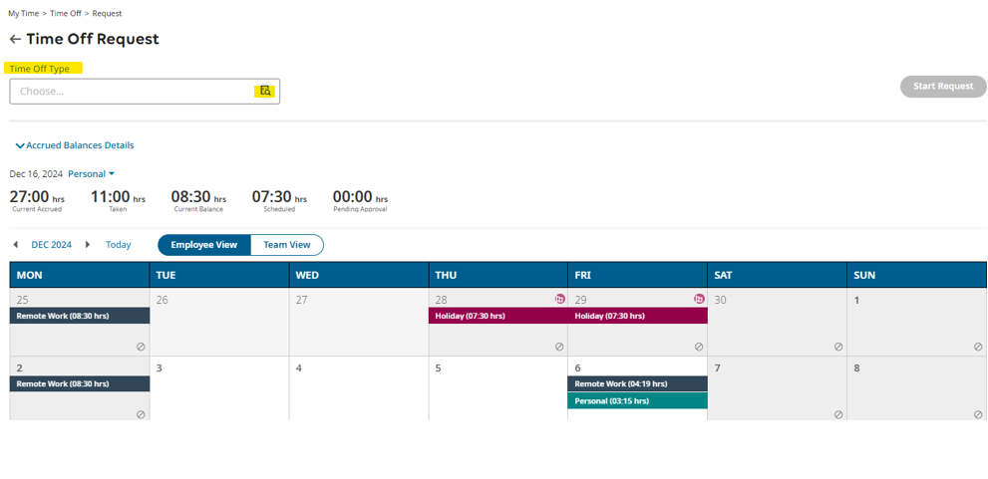
Request Time Off
In the field at the top left, choose the Time Off Type
Once type is selected, click Start Request at the top right
Enter the details of the time off request
Click Submit Request

Slide 17
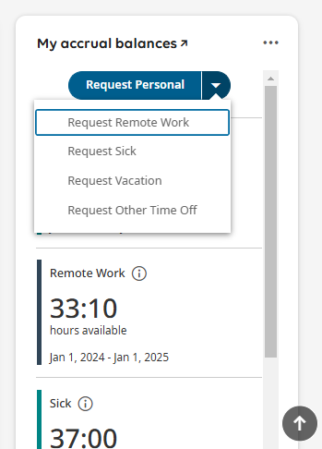
Request Time Off
You can also request time off by navigating to the My accrual balances widget on your dashboard:
Click the dropdown arrow to select the time off type
Enter the details of the time off request (i.e., full, partial, or multiple day(s), amount of hours, comment)
Click Submit Request

Slide 18
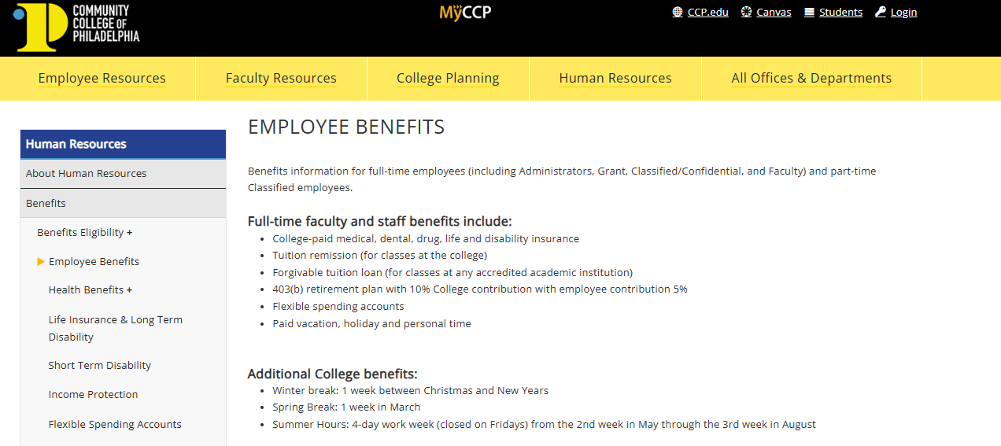
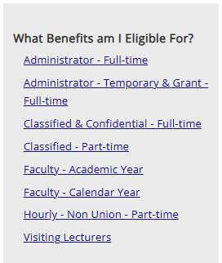
PTO Eligibility
For more information on PTO policies and other benefits eligibility information:
Visit the Employee Benefits page on the college website
Select your employee classification

Slide 19
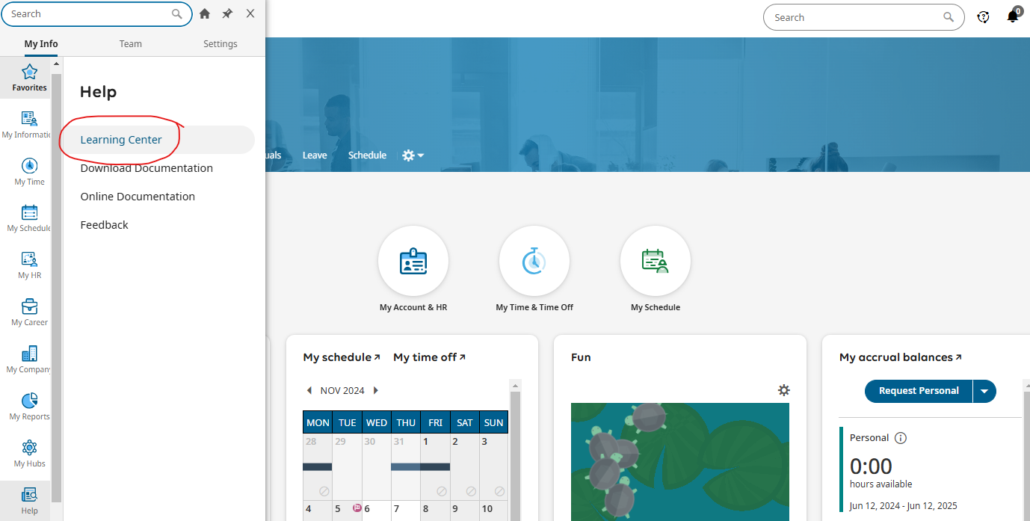
Resources and Support
For resources and training materials:
Visit the Learning Center located in the menu on your Kronos dashboard by clicking the Help tab, then Learning Center
Visit the Time and Attendance Training Materials page on the college website
For other Kronos related questions, please contact Kronos@ccp.edu

Slide 20
Thank you for attending this Webinar!

