Slide 1
Retirement
Options
Try installing Poppins in template via desktop PPT
How to make custom frame: insert picture > go to "Crop" and click "crop to shape" > crop again to adjust shape itself but make sure picture is not stretched/compromised

Slide 2
Retiree Medical Insurance Eligibility
Age and fulltime service must equal at least 77
Must be at least 62 & have 10 or more years of fulltime service
Please note, part-time service does not count towards your eligibility unless you are a visiting lecturer.

Slide 3
Benefits Available
Life Insurance
All retirees are able to stay on CCP’s group life insurance policy until age 65.
You will have the option to convert your life insurance to an individual whole-life policy at age 65
Medical Benefits
Union Retirees stay on CCP’s benefits at no cost until 9/30 after reaching age 65
Non-union Retirees stay on CCP’s benefits at no cost until 7/31 after reaching age 65
Spouses under 65 also stay on CCP’s benefits at no cost until
Union until 9/30 after reaching age 65
Non-Union until 7/31 after reaching age 65
At age 65 Retirees and Spouses enroll in Medicare and select a supplemental medical plan. Retirees and Spouses pay 50% of the cost of coverage.
Retiree 65 Plus (Medicare Supplement)
Keystone 65 (Medicare Advantage Plan)
Retirees and Spouses have the same prescription and dental coverage they had when the retiree was an active employee. Retirees and Spouses pay 50% of the cost of coverage.
CVS Caremark for Prescription
Delta Dental or United Concordia for Dental

Slide 4
Why is Supplemental Insurance Needed?
Retiree 65 Plus (formally Medigap F) is Medicare Supplement Insurance that helps fill "gaps" in Original Medicare and is sold by private companies. Original Medicare pays for much (about 80%), but not all (remaining 20%), of the cost for covered health care services and supplies. A Medicare Supplement plan can help pay some of the remaining health care costs such as:
Copayments
Coinsurance
Deductibles

Slide 5
Supplement vs Medicare Advantage (MA)
Medicare Supplement insurance plans work with Original Medicare, Part A and Part B, and may help pay for certain costs that Original Medicare doesn't cover. In contrast, Medicare Advantage plans are an alternative to Original Medicare. If you enroll in a Medicare Advantage plan, you're still in the Medicare program.
Medigap covers the 20% that Medicare doesn’t at 100% in most cases.
The Retiree 65 Plus (Supplement Plan) is significantly cheaper than the Keystone 65 Plan (MA).
The Keystone 65 Plan (MA) includes basic preventative dental (No major dental services) and vision.
You are limited to the Tri-State area (specifically the contiguous counties next to Philadelphia PA and part of New Jersey) with the Keystone 65 Plan. The Retiree 65 Plus Plan is available in every state.

Slide 6
When Do I need to Apply for Medicare?
If you are retiring before age 65, you do not need to contact Medicare to apply for Parts A & B until 3 months before your 65th birthday. Once you turn 65 you are required to come off of CCP’s active employee medical plan and be moved to Retiree 65 Plus or Keystone 65.
If you are retiring after age 65, you would have already been enrolled in Medicare Part A. You will need to contact Medicare to enroll on Medicare Part B before your retirement date.
You do NOT need to sign up for Medicare Part D (Prescription Coverage) if you are signing up for the CCP Retiree Medical Package.

Slide 7
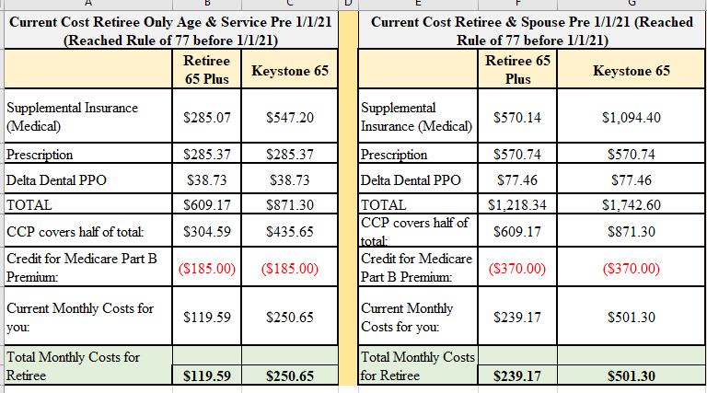
Retiree Medical Rates w/ Cost Share
Rates are Subject to Change
You meet the age and service requirements before 1/1/21

Slide 8
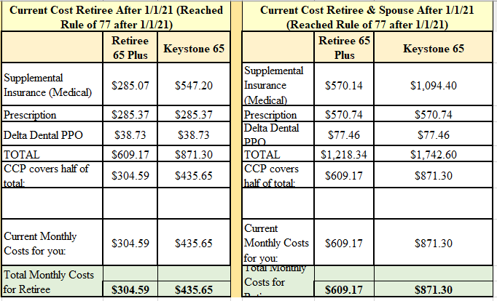
Retiree Medical Rates w/ Cost Share
Rates are Subject to Change
You meet the age and service requirements after 1/1/21

Slide 9
Retiree Medical Rates w/ Spouse Under Age 65
Rates are Subject to Change
Rates if you Retire and your Spouse is UNDER 65

Slide 10
RIO Facts
Age and full-time service must equal 80 (must be at least age 63 with at least 20 years of service).
Employees eligible for RIO are eligible for Retiree Medical as well.
RIO offers are generally made each year in July.
Employees who are offered RIO must accept the offer by 11/15 of the current year.
RIO is offered for a maximum of 3 years if not accepted.

Slide 11
Retirement Incentive Age 63 & 20 Years of Service
Retirement Incentive Age 63 & 20 Years of Service

Slide 12
Step-Down Retirement Option for Faculty
Eligibility starts the academic year in which Faculty reaches age 66
Must have 20 years of FT service (includes Visiting Lecturer service)
Year 1 workload reduced to 75% = 100% salary
Year 2 workload reduced to 50% = 100% salary
Year 3 workload reduced to 25% = 50% salary
Must retire at end of Academic Year 3
Self-elect program with a deadline of Feb 15 to notify department head

Slide 13
Things to Note
You can always make changes to your medical plan. If you initially choose a plan and want to switch to another plan later, you may do so.
If you choose not add dependents after your initial retirement date, and opt to just cover yourself on retiree benefits, you can not opt to cover a dependent at a later time.
If you opt out of medical coverage at your time of retirement you can not choose to add it later.
Retiree medical payments are deducted automatically via ACH from your account on the 20th of each month. ACH payments are required as we do not accept checks.

Slide 14
Resources
Medicare
Phone Number 800-633-4227
Website - https://www.medicare.gov/
Social Security
Phone Number 800-772-1213
Website – www.ssa.gov
Benefits Team
benefits@ccp.edu
https://myccp.online/human-resources/retiree-benefits
https://www.medicare.gov/basics/get-started-with-medicare

